Slide 1
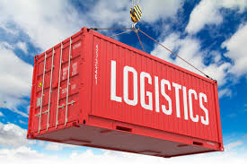
Spare part logistics
Determining AND CONTROLLING LOGISTICS WITH THE HELP OF MACHINE LEARNING

Slide 2
Current statistics
Defectives in a Quarter (15,000 parts) ..Approx. (200 parts a day)
Total Install Bases across the globe (12 + Million)
Total Inventory available today (200,000 parts)
Total Cost (Approx 100 Million)
Total Depot locations 487 globally
Total Parts 2350

Slide 3
Why ML
Forecast results into 10% misses in a part delivery due to lack of planning.
Logistics are in large part controlled by planners and its highly labor intense task
Not humanly possible to continuously surveil and make connections in large scale operations
Need for more automation in monitoring and reporting

Slide 4
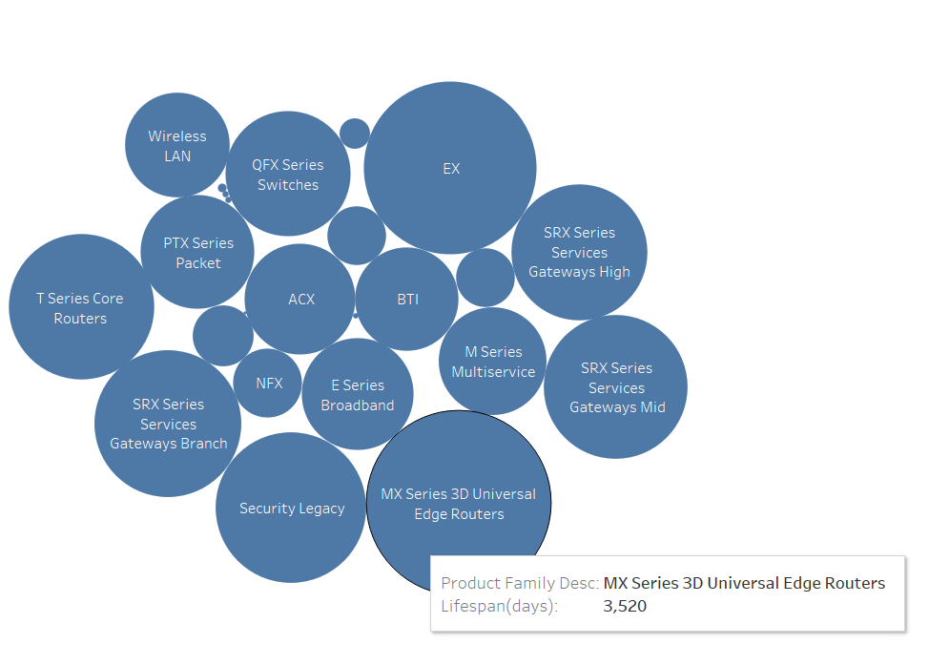
Life span by product family

Slide 5
Data Set
384 defectives only???
Df.shape()
1,408,350 rows by 2,353 columns
1.2 MILLIONNN
83,000

Slide 6
ML Models
Machine learning model:
Linear regression ..24 %
Deep Learning.. 97%
Tableau visualization

Slide 7
Conclusions
Based on the Life span , we can say which Part should be considered as EOL (End of Life)
This will help to plan a part at the right Depot and ultimately minimize the inventory Cost

